Slide 1
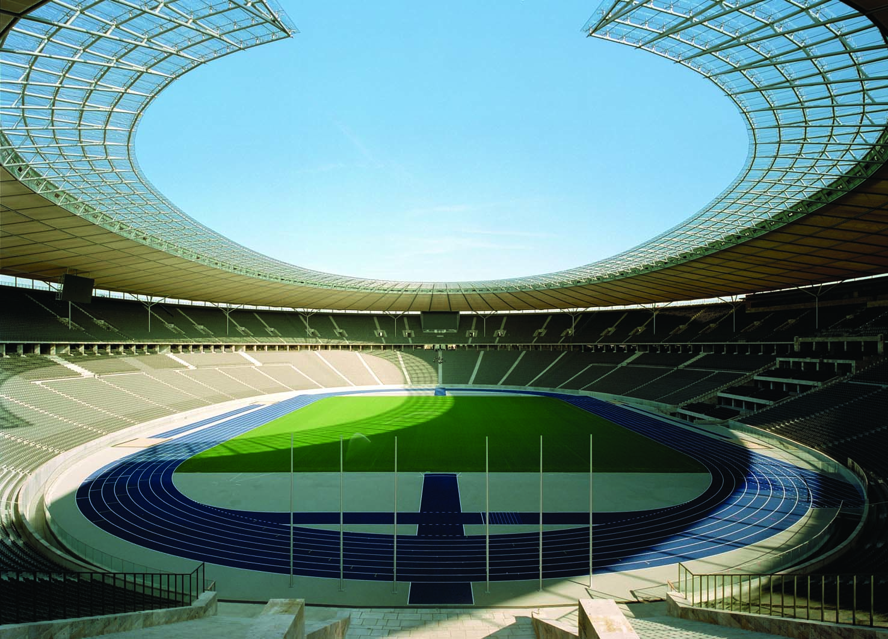
2
SUPPLY AND DEMAND I: HOW MARKETS WORK

Slide 2
4
The Market Forces of Supply and Demand

Slide 3

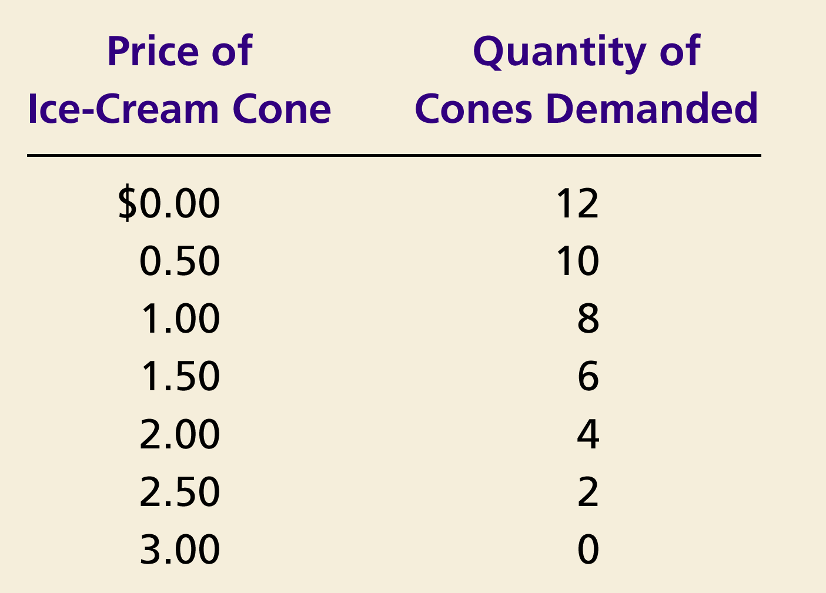
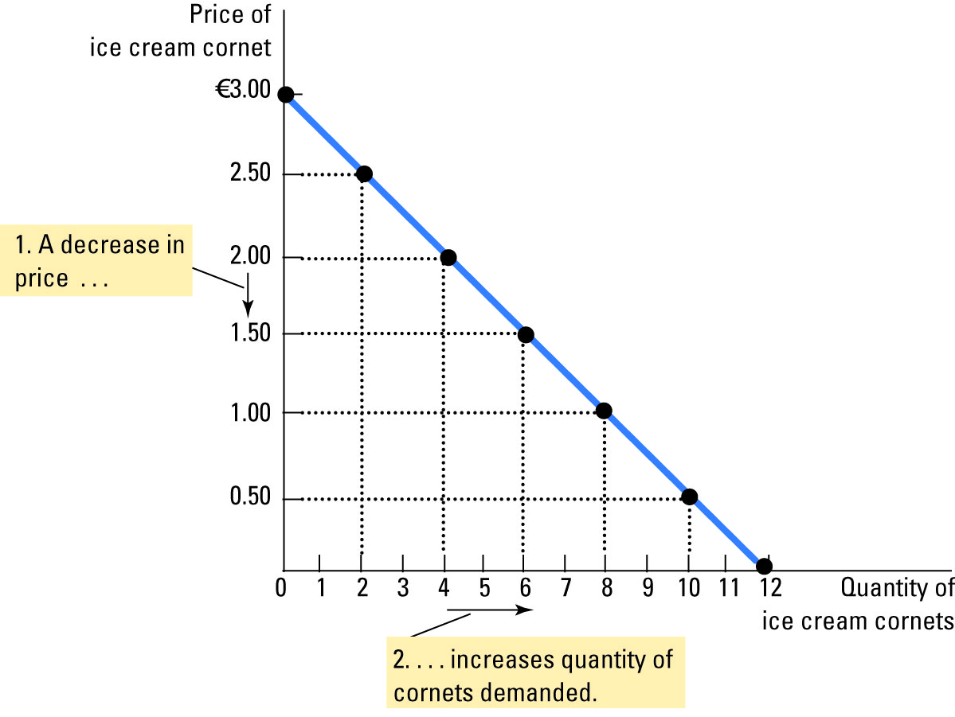
Figure 1 Catherine’s Demand Schedule and Demand Curve
Copyright © 2004 South-Western

Slide 4
Figure 3 Shifts in the Demand Curve
Price of
Ice-Cream
Cone
Increase
in demand
Decrease
in demand
Demand
curve,
D
2
Demand
curve,
D
1
Demand curve,
D
3
0
Quantity of
Ice-Cream Cones
Copyright©2003 Southwestern/Thomson Learning

Slide 5

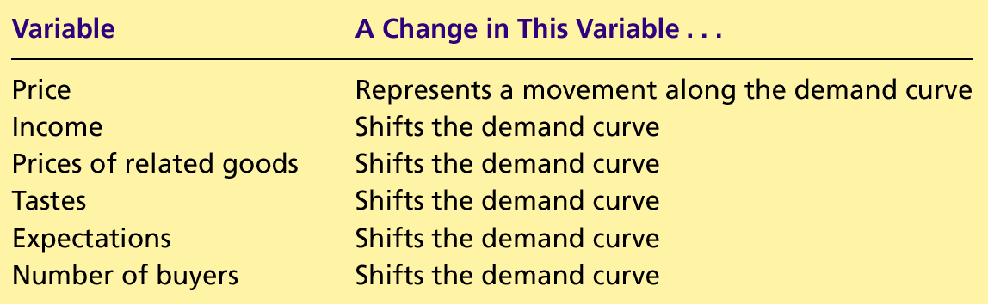
Table 1 Variables That Influence Buyers
Copyright©2004 South-Western

Slide 6
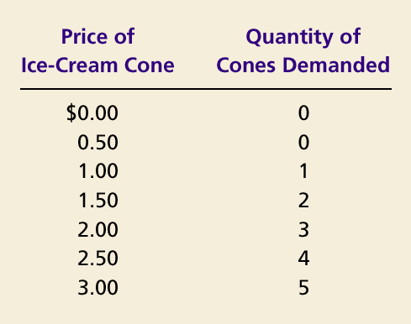
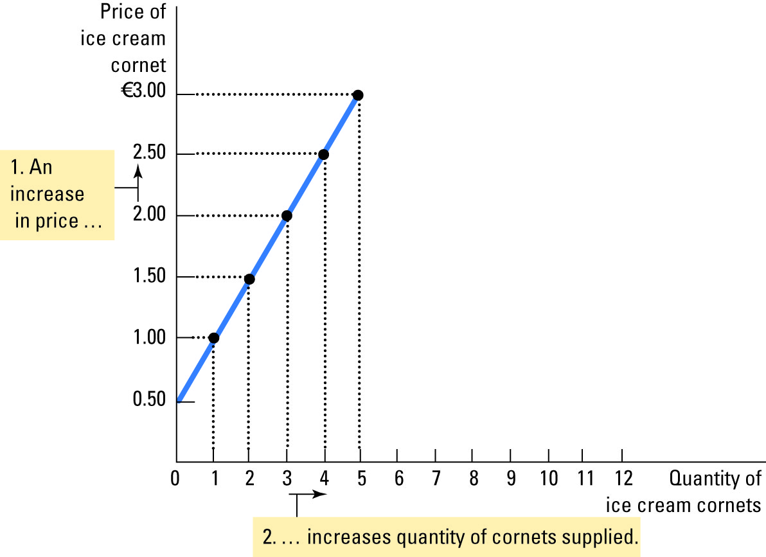
Figure 5 Ben’s Supply Schedule and Supply Curve
Copyright©2003 Southwestern/Thomson Learning

Slide 7
Figure 7 Shifts in the Supply Curve
Price of
Ice-Cream
Supply curve,
S
3
Supply
Cone
curve,
S
1
Supply
Decrease
curve,
S
2
in supply
Increase
in supply
0
Quantity of
Ice-Cream Cones
Copyright©2003 Southwestern/Thomson Learning

Slide 8
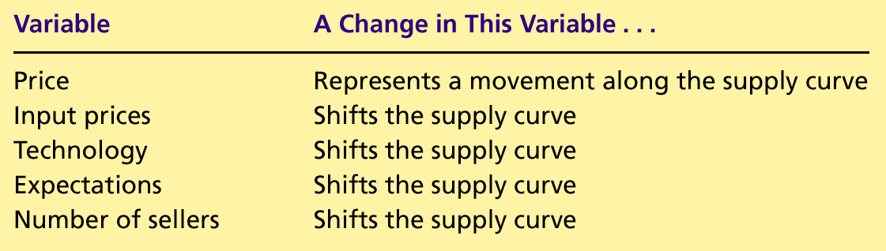
Table 2 Variables That Influence Sellers
Copyright©2004 South-Western

Slide 9
Figure 8 The Equilibrium of Supply and Demand
Price of
Ice-Cream
Cone
Supply
Equilibrium price
Equilibrium
€ 2.00
Equilibrium
Demand
quantity
0
1
2
3
4
5
6
7
8
9
10
11
12
13
Quantity of Ice-Cream Cones
Copyright©2003 Southwestern/Thomson Learning

Slide 10
Figure 9 Markets Not in Equilibrium
(a) Excess Supply
Price of
Ice-Cream
Supply
Cone
Surplus
€ 2.50
2.00
Demand
0
4
7
10
Quantity of
Quantity
Quantity
Ice-Cream
demanded
supplied
Cones
Copyright©2003 Southwestern/Thomson Learning

Slide 11
Equilibrium
Surplus
  When price > equilibrium price, then quantity supplied > quantity demanded.
    There is excess supply or a surplus.
    Suppliers will lower the price to increase sales, thereby moving toward equilibrium.

Slide 12
Figure 10 How an Increase in Demand Affects the Equilibrium
Price of
Ice-Cream
1. Hot weather increases
Cone
the demand for ice cream . . .
Supply
€ 2.50
New equilibrium
2.00
2. . . . resulting
Initial
in a higher
equilibrium
price . . .
D
D
0
7
10
Quantity of
3.
. . .
and a higher
Ice-Cream Cones
quantity sold.
Copyright©2003 Southwestern/Thomson Learning

Slide 13
Figure 11 How a Decrease in Supply Affects the Equilibrium
Price of
Ice-Cream
1. An increase in the
Cone
price of sugar reduces
S₂
the supply of ice cream. . .
S₁
New
€ 2.50
equilibrium
2.00
Initial equilibrium
2. . . . resulting
in a higher
price of ice
cream . . .
Demand
0
4
7
Quantity of
3.
. . .
and a lower
Ice-Cream Cones
quantity sold.
Copyright©2003 Southwestern/Thomson Learning

Slide 14
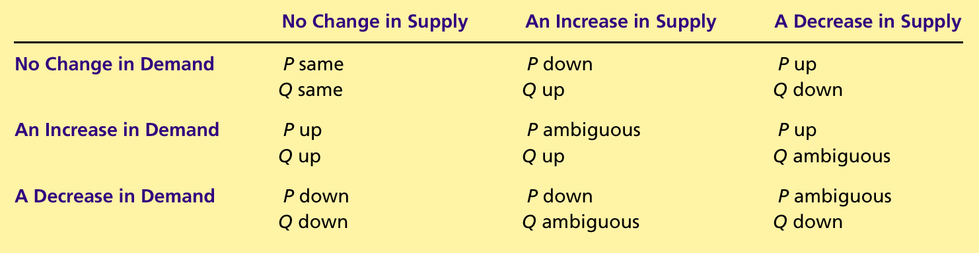
Table 4 What Happens to Price and Quantity When Supply or Demand Shifts?
Copyright©2004 South-Western

